Slide 1
WELCOME TO
CSE DEPARTMENT
CONGRATULATIONS!!
Lecturer Saifur Rahman, Dept. of CSE, United International University
1

Slide 2
Overview of The Course
Introduction to Computer Systems (CSE 1110)
Course Credit: 1.0
Lecturer Shekh. Md. Saifur Rahman
Objective of the Course
To gain an overview of Computer systems and learn basic computer programming

Slide 3
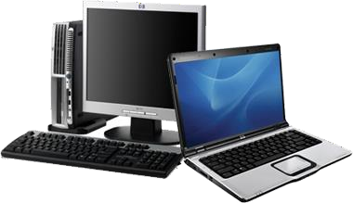
Introduction to computer
Computer
Computer is an electronic device that stores, retrieves, and processes data.
It takes data as input, process it and then give information as output.
Processed data is called information.
Input is processed, produce output – this is directed by the software but performed by the hardware.

Slide 4
Characterstics of Computer
Automatic
Computer is an automatic machine.
Once a program is given to computer i.e. stored in computer memory, the program and instruction can control the program execution without human interaction.
High Speed
Computer is a very fast device. It is capable of performing calculation of very large amount of data.
The computer has units of speed in microsecond, nanosecond, and even the picosecond.
It can perform several billions (10⁹ ) , even trillions (10¹² )
simple arithmetic calculations in a second

Slide 5
Characterstics of Computer
Accuracy
The calculations are 100% error free.
Computers perform all jobs with 100% accuracy provided that correct input has been given.
Diligence
Unlike human beings, a computer is free from monotony, tiredness and lack of concentration.
It can work continuously without any error and boredom.
It can do repeated work with same speed and accuracy.

Slide 6
Characterstics of Computer
Versatility
A computer is a very versatile machine.
A computer is very flexible in performing the jobs to be done.
This machine can be used to solve the problems related to various fields.
At one instance, it may be solving a complex scientific problem and the very next moment it may be playing a card game.
Power of Remembering
Memory is a very important characteristic of computers.
A computer has much more storage capacity than human beings.
It can store large amount of data.
It can store any type of data such as images, videos, text, audio and many others.

Slide 7
Characterstics of Computer
No I.Q
A computer is a machine that has no intelligence to perform any task.
Each instruction has to be given to computer.
A computer cannot take any decision on its own.
No Feeling
Computers have no feelings or emotions.
It cannot make judgment based on feeling, taste, experience,
and knowledge unlike a human being.

Slide 8
Evolution of Computer
First Generation
1946-1959. Vacuum tube based.
Second Generation
1959-1965. Transistor based.
ENIAC, IBM 701
Honeywell 400, IBM 7030
Third Generation
1965-1971. Integrated Circuit based.
Fourth Generation
IBM 360/370, CDC 6000
1971-1980. VLSI microprocessor based. CRAY-X-MP(Super Computer), DEC 10
CRAY-1(Super Computer),
Fifth Generation 1980-onwards.
ULSI microprocessor based
Desktop, Laptop

Slide 9
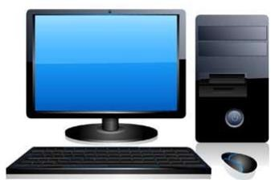
Introduction to computer Types
1. PC (Personal Computer)
It is a single user computer system having moderately powerful microprocessor

Slide 10
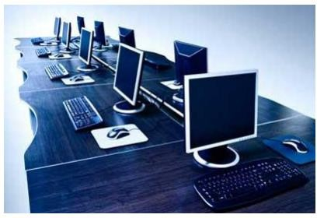
Types
Introduction to computer
2. WorkStation
It is also a single user computer system which is similar to personal computer but have more powerful microprocessor.

Slide 11
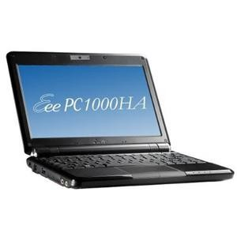
Introduction to computer
Types
3. Notebook Computer
Small in size. Used by individual users.

Slide 12
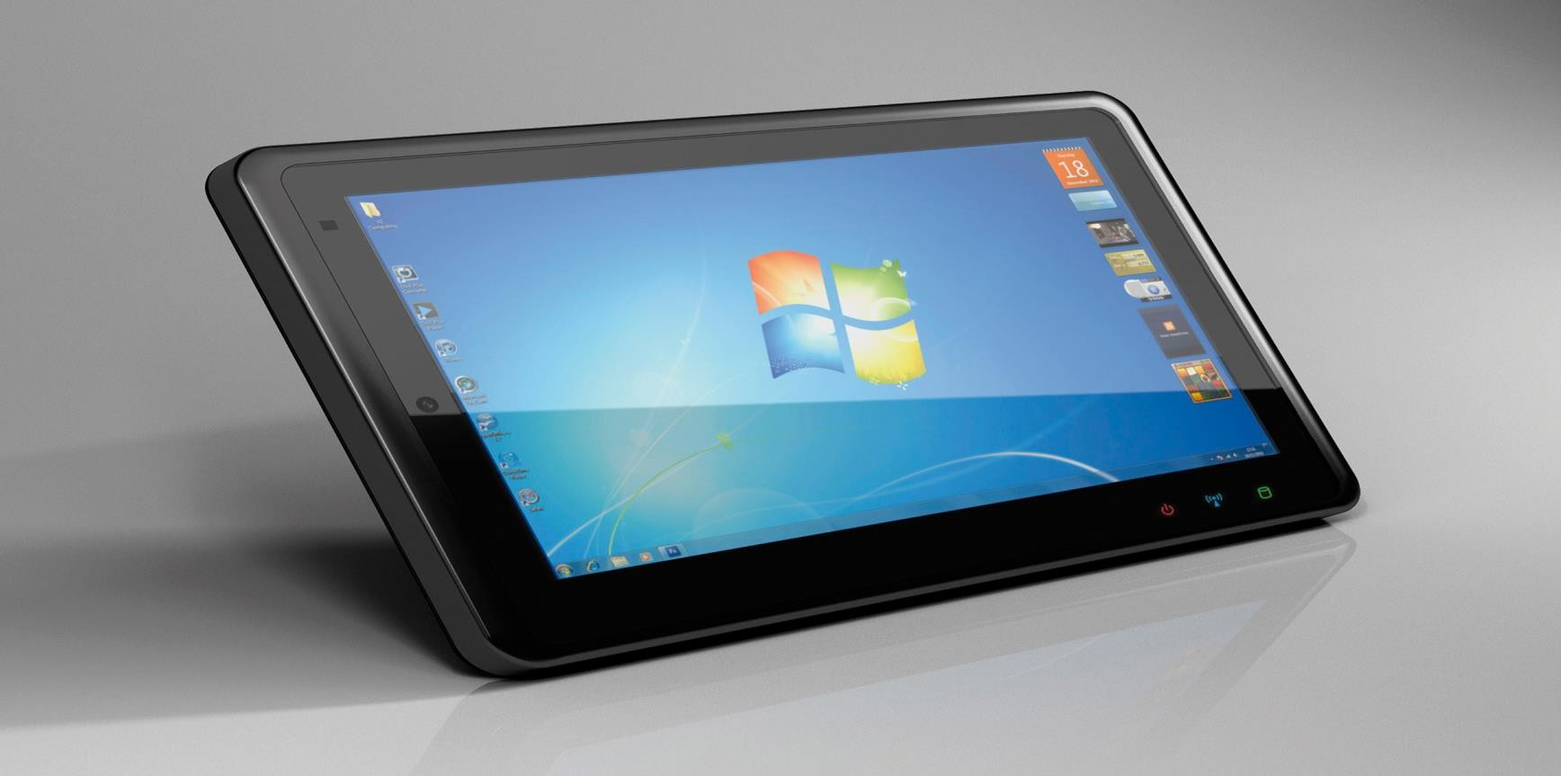
Introduction to computer
Types
4. Tablet Computer
Small in size. Used by individual users.
It has all notebook’s functionality but lighter than notebook.
Accept input from a stylus or digital pen.

Slide 13
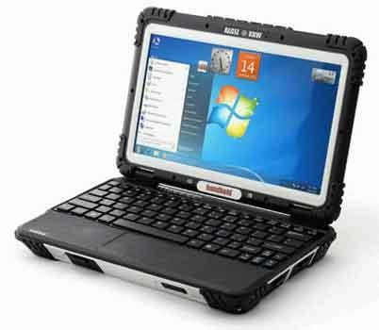
Introduction to computer
Types
5. Handheld Computer Small enough to fit in your hand.
Popular handheld computer is PDA ( Personal Digital Assitant). Not lager than a small appointment book

Slide 14
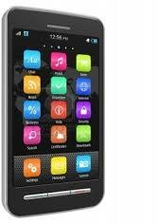
Introduction to computer
Types
6. Smart Phone
Some cellular phones doubled as miniature PCs Offers advanced features

Slide 15
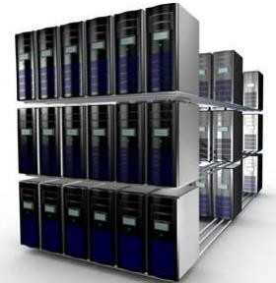
Types
Introduction to computer
In terms of sizes
Super Computer
It is an extremely fast computer which can execute hundreds of millions
of instructions per second.
Most powerful in terms of data processing and performance.

Slide 16
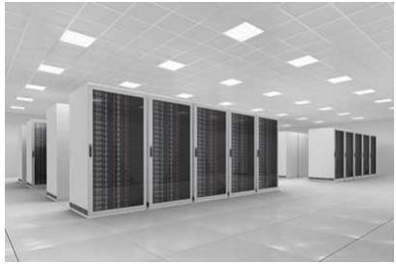
Introduction to computer
Types
Main Frame
Not as powerful as supercomputer
Mainframes can also process & store large amount of data
Used in large organization

Slide 17
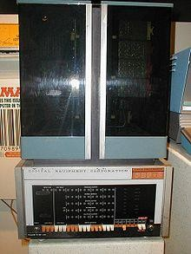
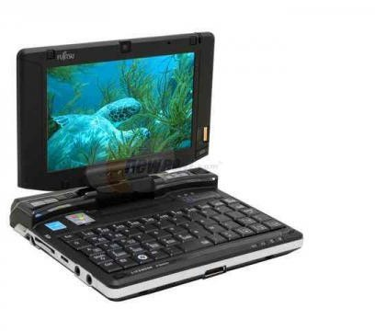
Introduction to computer Types
Minicomputer
Used for specific purposes
“Midrange Computers”
Individual departments of a large company or organizations
3.

Slide 18
Introduction to computer Types
Microcomputer
Desktop , laptops, personal digital assistant (PDA), tablets & smart phones
Widely used & the fastest growing computers
4.

Slide 19
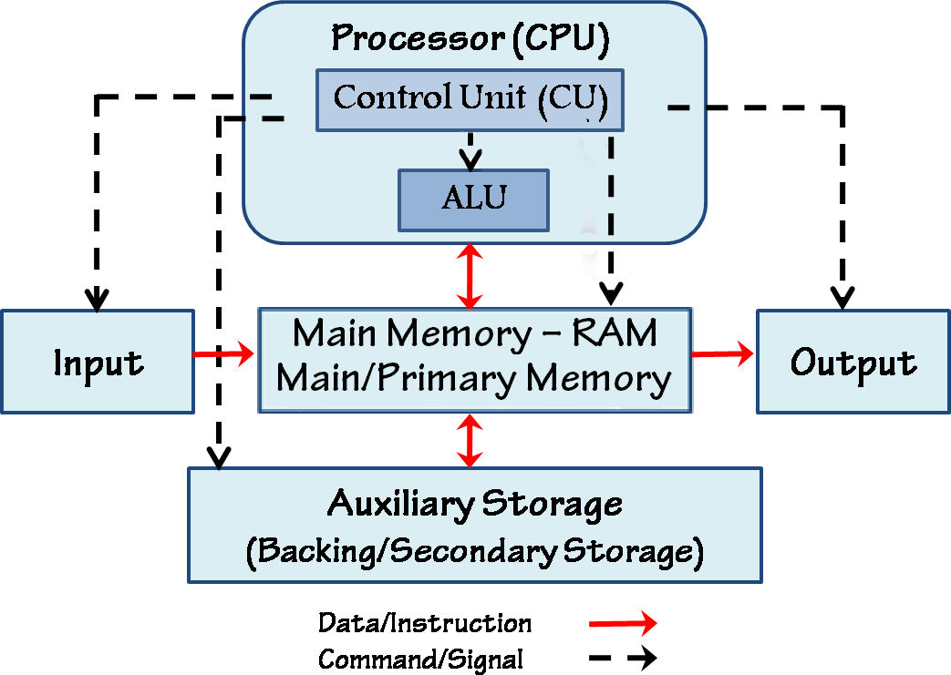
Basic Functions of Computer
Inputting
Storing
Processing
Outputting
Controlling

Slide 20
Parts of Computer System
Computer system has four parts . This parts combindly create computer system.
Hardware
Software
Data
User

Slide 21
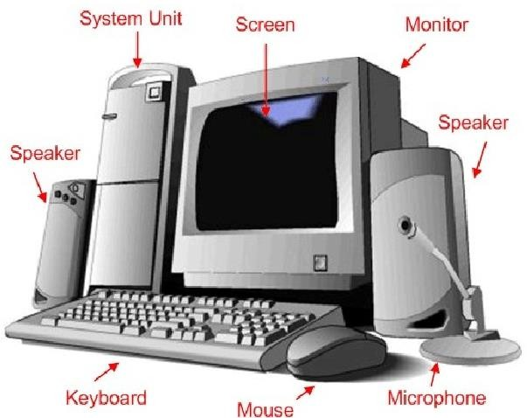

Hardware
Parts of Computer System
Physical equipment that performs basic function of data processing.
We can see or touch the parts of hardware.
It consists of ---
CPU (Center processing Unit)
Memory unit
Input devices
Output devices
Secondary storage devices
But where is the SOFTWARE ?

Slide 22
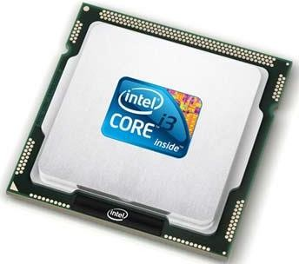
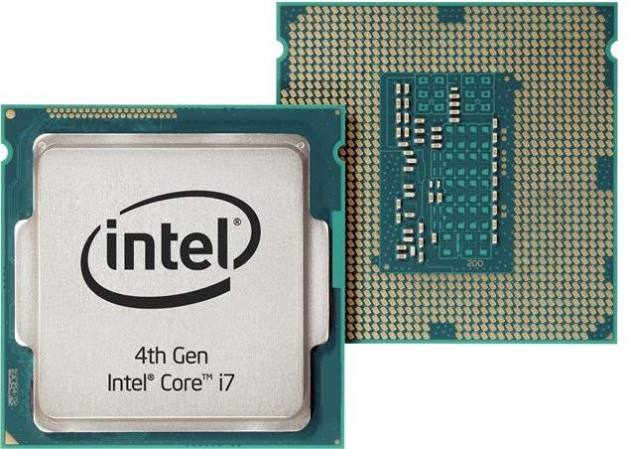
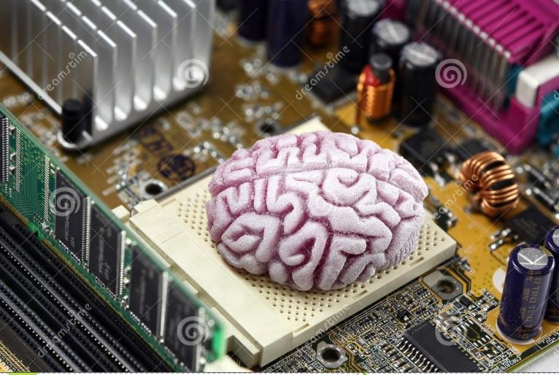
CPU – Central Processing Unit
Hardware
CPU consists of the following features:
CPU is considered as the brain of the computer.
CPU performs all types of data processing operations.
It stores data, intermediate results and instructions(program).
It controls the operation of all parts of computer.

Slide 23
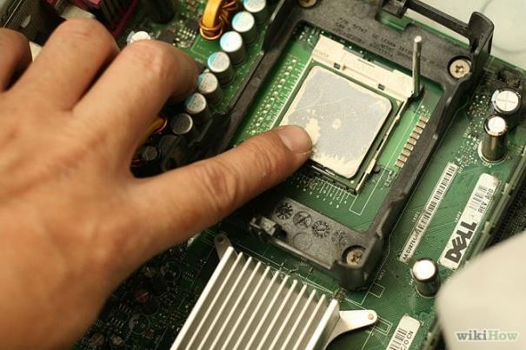
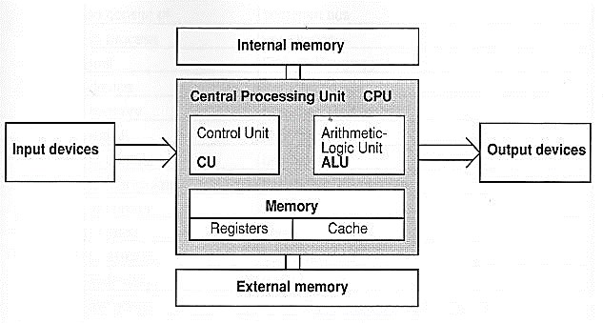
Hardware
CPU

Slide 24
Memory
Hardware
Memory is used to store data and instructions
Computer memory is the storage space in computer where data is to be processed and instructions required for processing are stored
Memory is primarily of three types
-- Cache Memory
-- Primary Memory/Main Memory
-- Secondary Memory

Slide 25
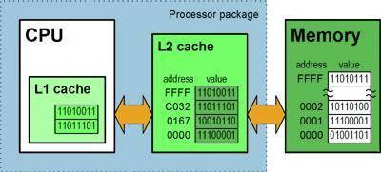
Memory
Hardware
Cache Memory
Cache memory is a very high speed semiconductor memory which can speed up CPU.
It acts as a buffer between the CPU and main memory

Slide 26
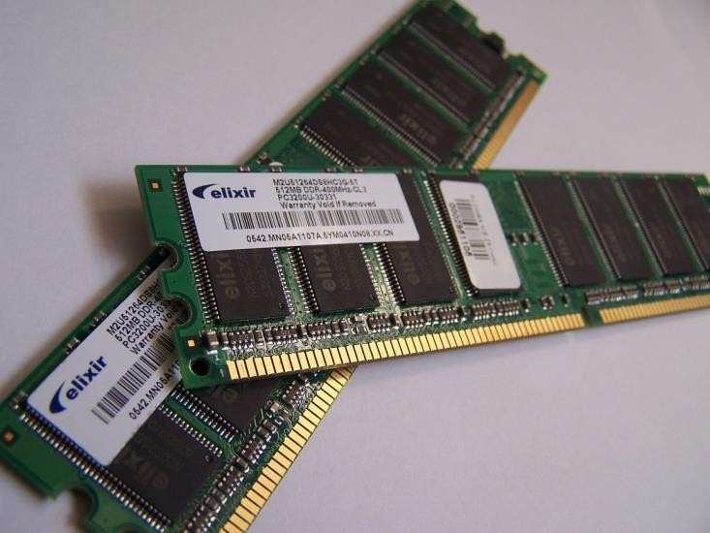
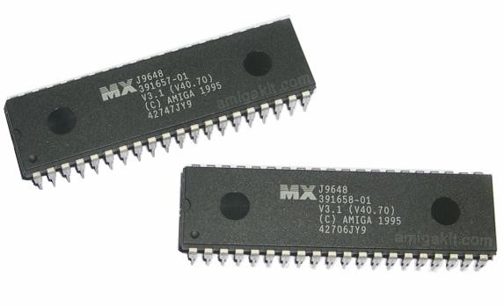
Memory
Hardware
Primary Memory (Main Memory)
Primary memory holds only those data and instructions on which
computer is currently working
It is divided into two subcategories RAM and ROM

Slide 27
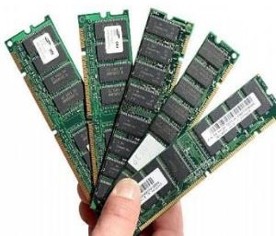
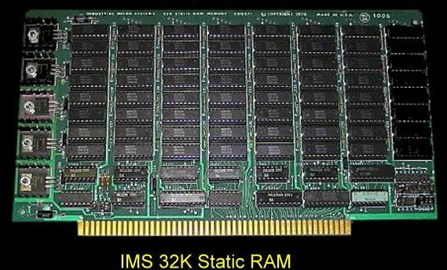
Memory
Hardware
RAM (Random Access Memory)
RAM(Random Access Memory) is the internal memory of the CPU for storing data, program and program result.
Volatile
It has two types—
Static RAM
Dynamic RAM

Slide 28
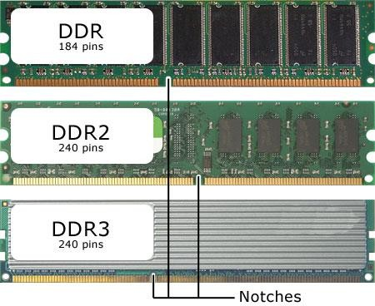
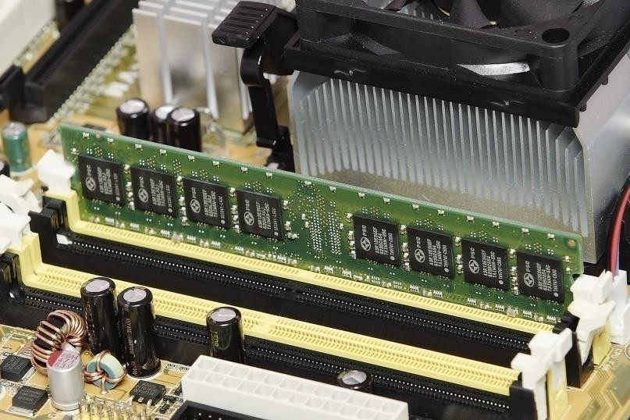
Memory
Hardware
RAM (Random Access Memory)

Slide 29
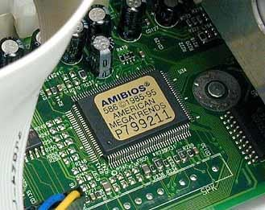
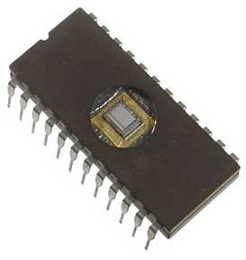
Memory
Hardware
Read Only Memory (ROM)
The memory from which we can only read but cannot write on it.
Non-volatile.
Information is stored permanently during manufacture

Slide 30
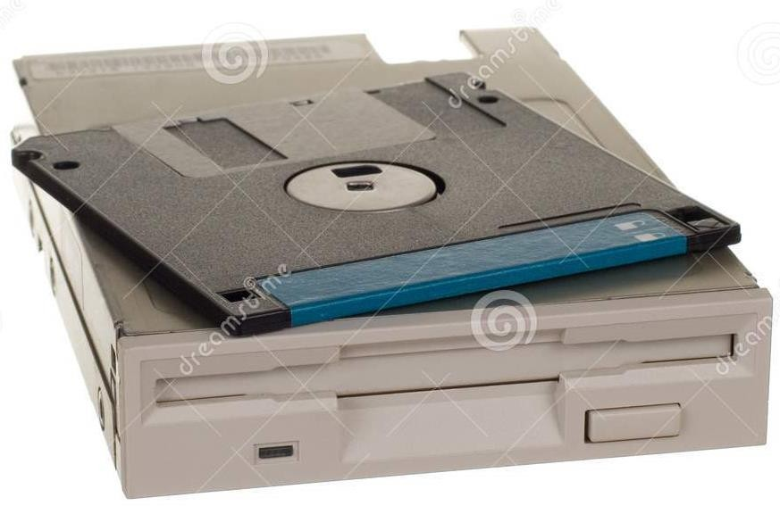
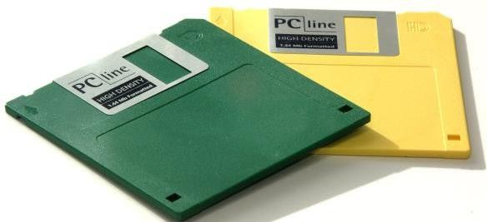
Memory
Hardware
Secondary Memory
Also known as external memory or non-volatile.
Slower than main memory.
Used for storing data/information permanently
Floppy Drive

Slide 31
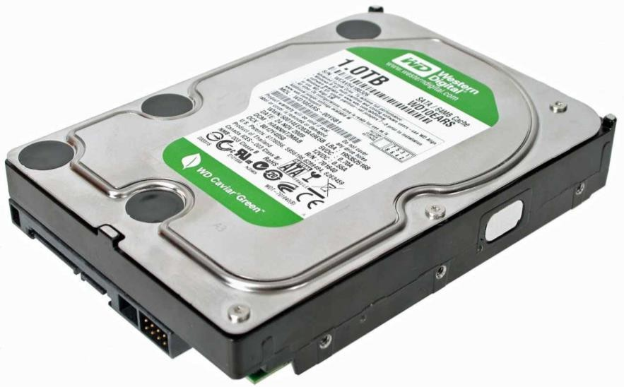
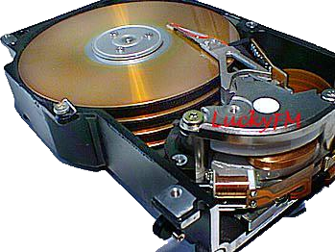
Memory
Hardware
Secondary Memory
Hard Disk or Drive

Slide 32
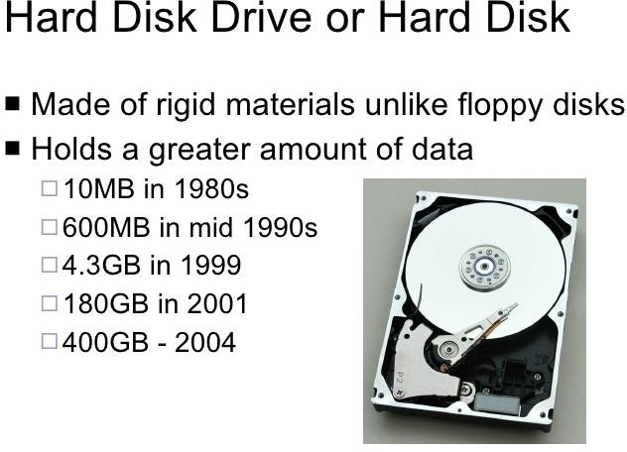
Memory
Hardware
Hard disk is a higher capacity drive.
It also stores the operating system which runs when we turn on the computer.
Non-volatile
Stores data in magnetic disk
Speed: very fast, measured
in milliseconds.
The smaller this number faster the disk.
Capacity: enormous.
Cost: cheap

Slide 33
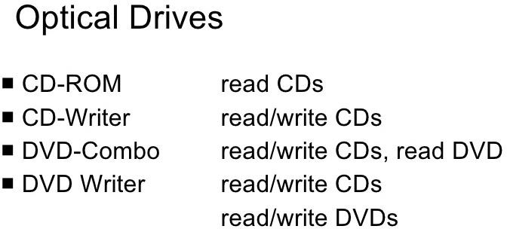
Memory
Hardware

Slide 34
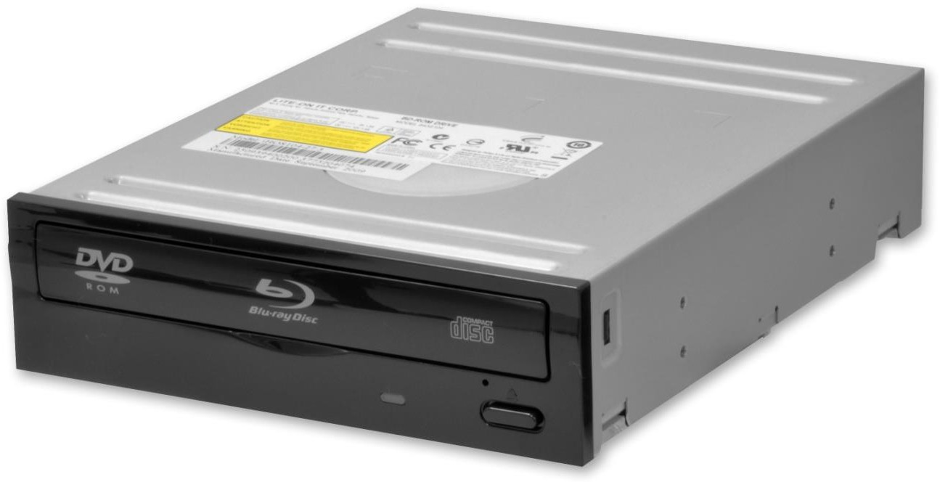
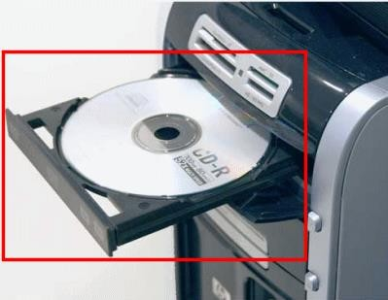
Memory
Hardware
Secondary Memory
Optical Drive.. CD, DVD

Slide 35
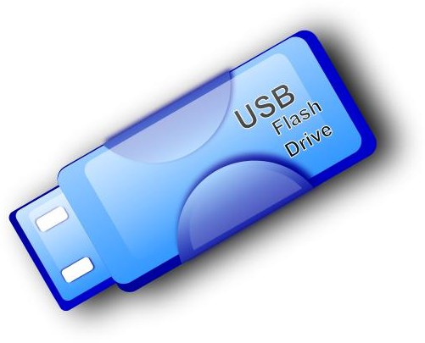
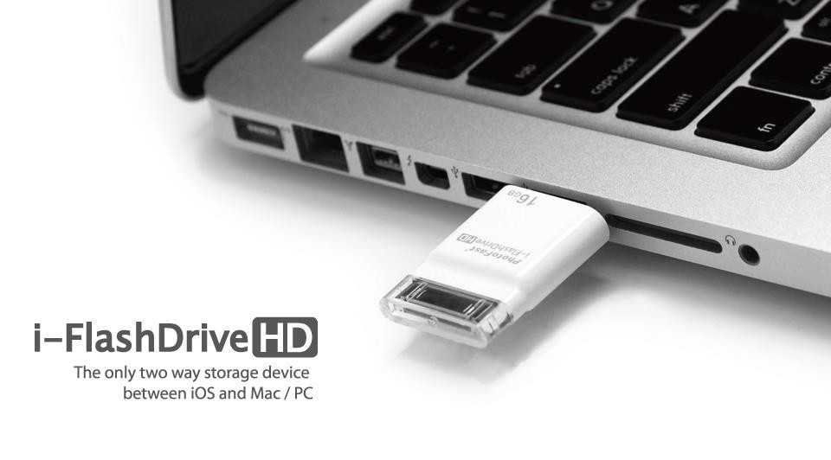
Memory
Hardware
Secondary Memory
Flush/Pen Drive

Slide 36
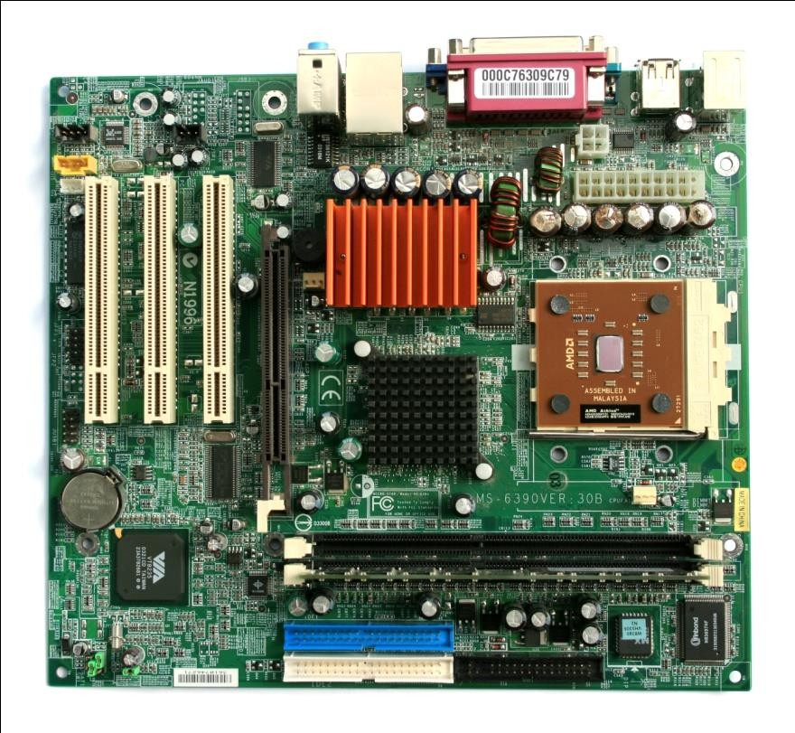
Motherboard
Hardware
Serves as a single platform to connect all of the parts of a computer together.
Connects CPU, memory, hard drives, optical drives, video card,
sound card, and other ports and expansion cards directly or via cables.
It can be considered as the backbone of a computer.

Slide 37
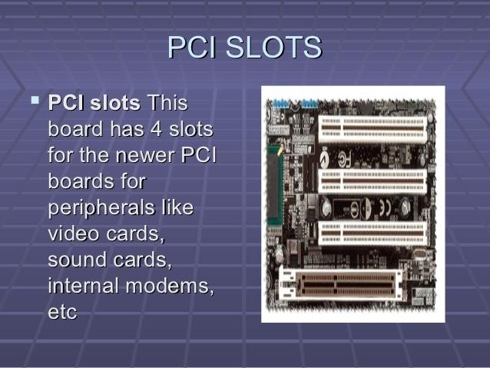
Motherboard
Hardware

Slide 38
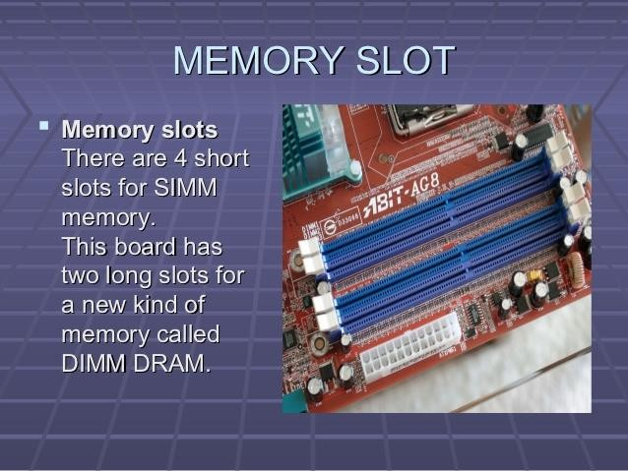
Motherboard
Hardware

Slide 39
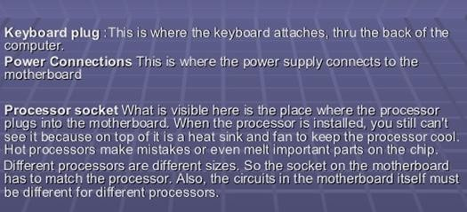
Motherboard
Hardware

Slide 40
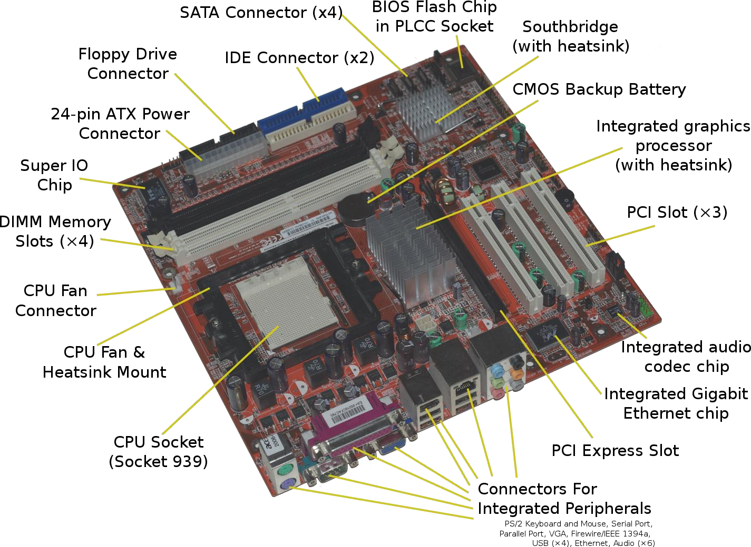
Motherboard
Ports

Slide 41
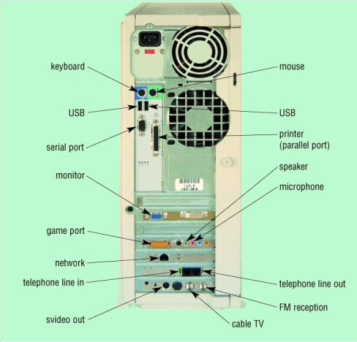
Motherboard
Ports
Ports are sockets that allow you to plug in device connectors to access the common electrical bus on the motherboard.
Ports are usually found on the back of the system unit, but newer styles also have some of them conveniently located on the front.
Ports allow specific types of connectors (which partly reflects changing technology as well as various kinds of technology).

Slide 42
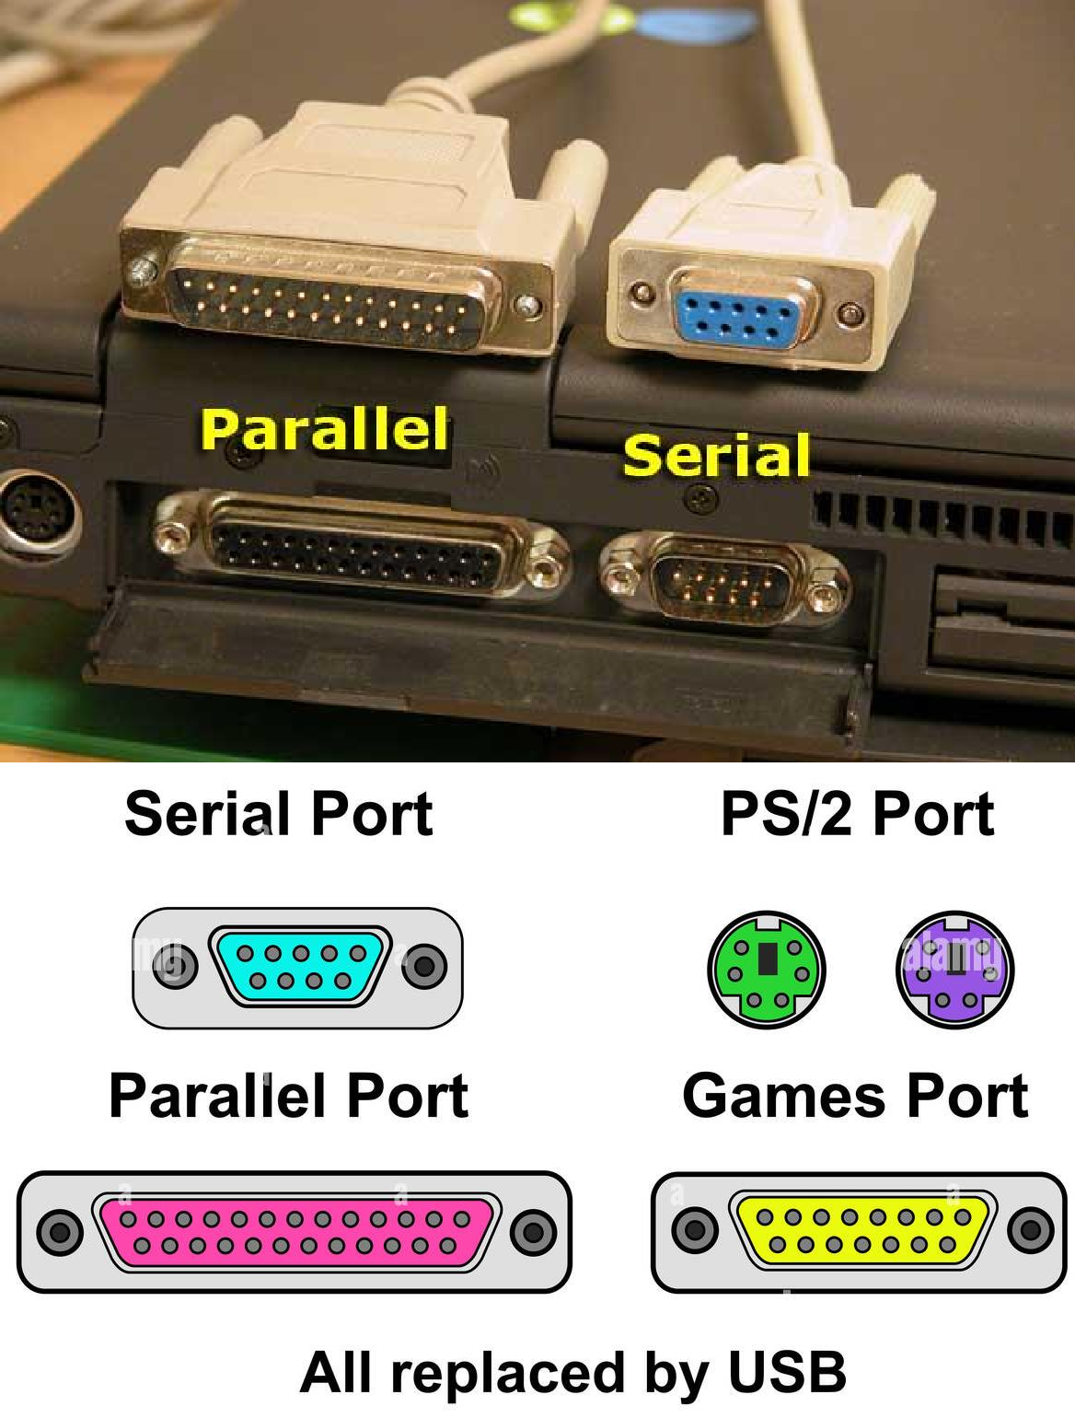
Motherboard
Ports
Types of Ports
Serial ports transmit data one bit at a time, like the picture on the left illustrates.
Parallel ports transmit more than one byte at a time.
These types of port designs are based on whether or not fast data transmission rates are required by the device or not.
Most computers come with basic types of ports (serial, parallel, keyboard, mouse, and USB); and expansion cards allow you to expand the available types needed by specific devices.

Slide 43
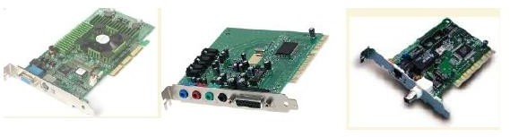
Motherboard
Cards/Slots
Expansion slots are sockets to provide direct connections to the common electrical bus, allowing you to insert a circuit board into the motherboard.
Typical Expansion Cards:
Video Cards
Sound Cards
Modem Cards
Network Interface Cards (NIC)
Laptops and portable computers typically have PC Cards – thin credit-card sized
devices used to add memory, disk drives, etc.

Slide 44
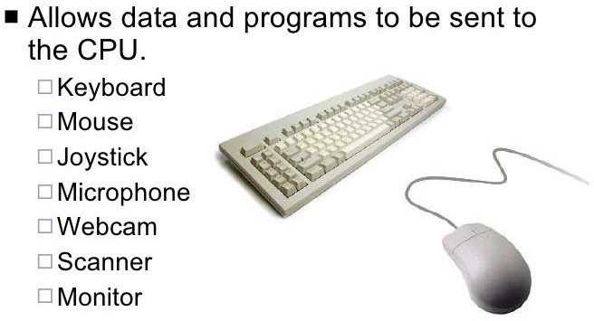
Input Devices
Hardware

Slide 45
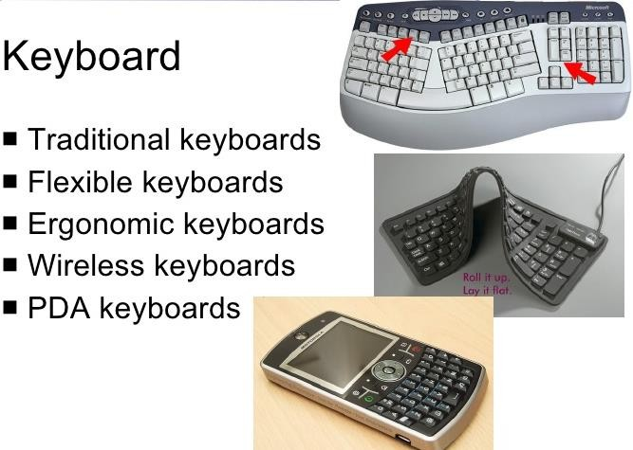
Input Devices
Hardware

Slide 46
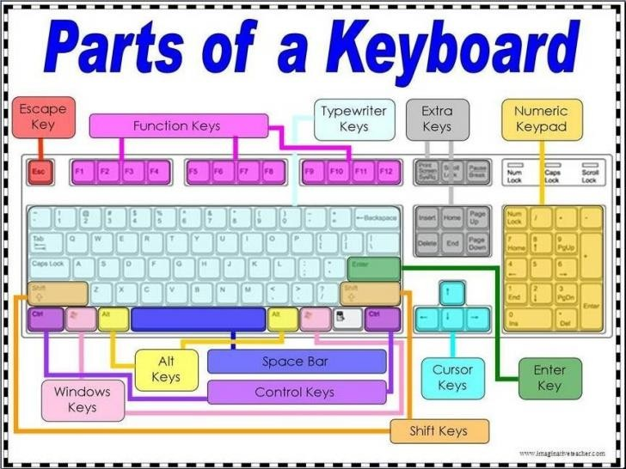
Input Devices
Hardware
Keyboard

Slide 47
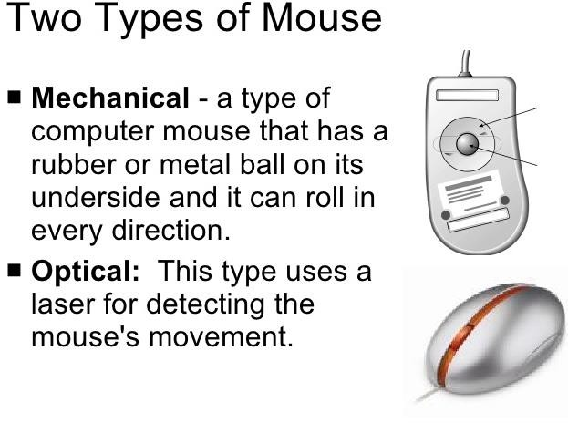
Input Devices
Hardware
Mouse

Slide 48
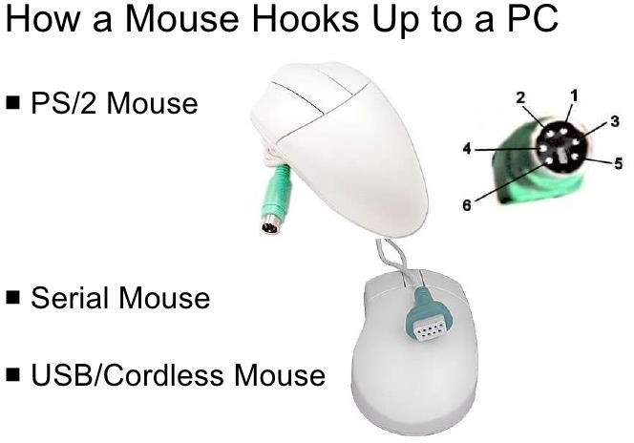
Input Devices
Hardware
Mouse

Slide 49


Input Devices
Hardware

Slide 50

Output Devices
Hardware
Monitor

Slide 51

Output Devices
Hardware

Slide 52

Output Devices
Hardware

Slide 53


Casing or Cover
Hardware

Slide 54

Power Supply
Hardware

